Slide 1

Artificial Intelligence
Module Number: 3.1
Module Name: Knowledge and reasoning

Slide 2
Syllabus
A Knowledge-Based Agent, Representation, Reasoning, and Logic, Prepositional Logic, An Agent for the Wumpus World, Problems with the propositional agent, First-Order Logic, Syntax and Semantics, Extensions and Notational Variations, Using First-Order Logic, A Simple Reflex Agent, Deducing Hidden Properties of the World, Toward a Goal-based Agent

Slide 3
Knowledge and Reasoning
AIM:
To create computer programs that can solve problems and achieve goals as humans would.

Slide 4
Knowledge and Reasoning
Objectives:
Become familiar with the basic principles of AI toward problem-solving, inference, perception, knowledge representation, and learning.
Investigate applications of AI techniques in intelligent agents, expert systems, artificial neural networks and other machine learning models

Slide 5
Knowledge and Reasoning
Outcomes:
Apply basic principles of AI in solutions that require problem solving, inference, perception, knowledge representation, and learning.
Demonstrate awareness and a fundamental understanding of various applications of AI techniques in intelligent agents, expert systems, artificial neural networks and other machine learning models.

Slide 6
Knowledge and Reasoning
Table of Content:
A Knowledge-Based Agent
Prepositional Logic
First-Order Logic
Simple Reflex Agent
Goal-Based Agent

Slide 7
Knowledge-Based Agent
An intelligent agent needs knowledge about the real world for taking decisions and reasoning to act efficiently.
Knowledge-based agents are those agents who have the capability of maintaining an internal state of knowledge, reason over that knowledge, update their knowledge after observations and take actions. These agents can represent the world with some formal representation and act intelligently.
Knowledge-based agents are composed of two main parts:
Knowledge-base and
Inference system.
Notes:
Source -- https://www.javatpoint.com/knowledge-representation-in-ai

Slide 8

Knowledge-Based Agent
Key issues:
Representation of knowledge → knowledge base
Reasoning processes → inference/reasoning
Knowledge base = set of sentences in a formal language representing facts about the world(*)
(*) called Knowledge Representation (KR) language
Notes:
Source --https://www.cs.cornell.edu/courses/cs4700/2013fa/slides/CS4700-knowl-repr-reas1_v5.pptx

Slide 9
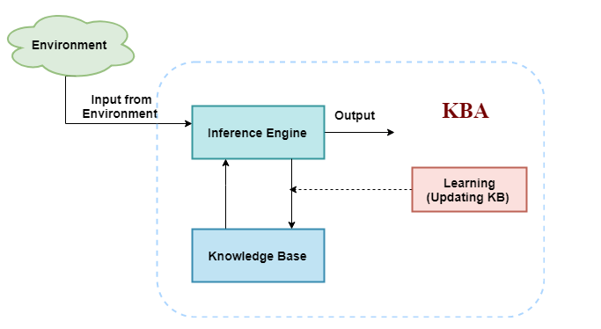
The architecture of knowledge-based agent
Notes:
Note: The image is copied from the Source -- https://www.javatpoint.com/knowledge-based-agent-in-ai

Slide 10
Knowledge-Based Agent
A subarea of Artiﬁcial Intelligence concerned with understanding, designing, and implementing ways of representing information in computers, so that programs (agents) can use this information:
to derive information that is implied by it
to converse with people in natural languages
to decide what to do next
to plan future activities
to solve problems in areas that normally require human expertise
Notes:
Source--https://cse.buffalo.edu/~shapiro/Courses/CSE563/Slides/krrSlides.pdf

Slide 11
Reasoning
Deriving information that is implied by the information already present is a form of reasoning.
Knowledge representation schemes are useless without the ability to reason with them.
So, Knowledge Representation and Reasoning (KRR).
Notes:
Source--https://cse.buffalo.edu/~shapiro/Courses/CSE563/Slides/krrSlides.pdf

Slide 12
What is a Logic?
Logic is the study of correct reasoning.
• It is not a particular KRR language.
• There are many systems of logic (logics).
• AI KRR research can be seen as a hunt for the “right” logic.
A language with concrete rules
No ambiguity in representation (may be other errors!)
Allows unambiguous communication and processing
Very unlike natural languages e.g. English
Many ways to translate between languages
A statement can be represented in different logics
And perhaps differently in same logic
Expressiveness of a logic
How much can we say in this language?
Not to be confused with logical reasoning
Logics are languages, reasoning is a process (may use logic)
Notes:
Source -- http://ccg.doc.gold.ac.uk/ccg_old/teaching/artificial_intelligence/lecture4.ppt
https://cse.buffalo.edu/~shapiro/Courses/CSE563/Slides/krrSlides.pdf

Slide 13
Prepositional Logic
Propositional logic (PL) is the simplest form of logic where all the statements are made by propositions. It is a technique of knowledge representation in logical and mathematical form.
What is a Proposition?
An expression in some language
that is true or false
whose negation makes sense
that can be believed or not
whose negation can be believed or not
Examples
Of propositions
Betty is the driver of the car.
Of non-propositions
How to ride a bicycle
Notes:
Source: https://www.javatpoint.com/the-wumpus-world-in-artificial-intelligence

Slide 14
Prepositional Logic
Two Types---
Atomic Propositions
2+2 is 4, it is an atomic proposition as it is a true fact.
"The Sun is cold" is also a proposition as it is a false fact.
Compound propositions
Compound propositions are constructed by combining simpler or atomic propositions, using parenthesis and logical connectives.
Example :"It is raining today, and the street is wet."
Notes:
Source: https://www.javatpoint.com/the-wumpus-world-in-artificial-intelligence

Slide 15

Prepositional Logic
Syntax
Propositions, e.g. “it is wet”
Connectives: and, or, not, implies, iff (equivalent)
Brackets, T (true) and F (false)
Semantics
Define how connectives affect the truth
“P and Q” is true if and only if P is true and Q is true
Use truth tables to work out the truth of statements
Notes:
Source: https://www.javatpoint.com/the-wumpus-world-in-artificial-intelligence

Slide 16
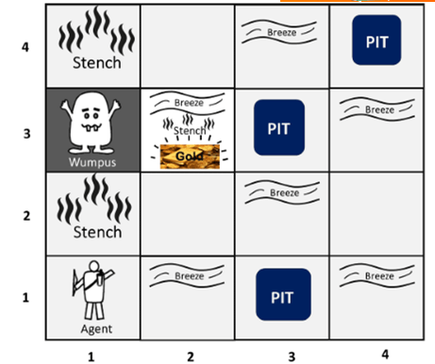
An Agent for the Wumpus World
The Wumpus World is a simple world example to illustrate the worth of a knowledge-based agent and to represent knowledge representation. It was inspired by a video game Hunt the Wumpus by Gregory Yob in 1973. The Wumpus World is a cave which has 4/4 rooms connected with passageways.
Notes:
Note: The image is taken from Source: https://www.javatpoint.com/the-wumpus-world-in-artificial-intelligence.
The Wumpus computer game.
The agent explores a cave consisting of rooms connected by passageways.
Lurking somewhere in the cave is the Wumpus, a beast that eats any agent that enters its room.
Some rooms contain bottomless pits that trap any agent that wanders into the room.
Occasionally, there is a heap of gold in a room.
The goal is:
to collect the gold and
exit the world
without being eaten

Slide 17
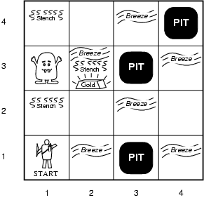
Wumpus World PEAS Description
Performance measure
gold: +1000, death: -1000
-1 per step, -10 for using the arrow
Environment
Squares adjacent to wumpus are smelly
Squares adjacent to pit are breezy
Glitter iff gold is in the same square
Shooting kills wumpus if you are facing it
Shooting uses up the only arrow
Grabbing picks up gold if in same square
Releasing drops the gold in same square
Sensors: Stench, Breeze, Glitter, Bump, Scream
Actuators: Left turn, Right turn, Forward, Grab, Release, Shoot
Notes:
Note: The image is taken from Source --https://www.ics.uci.edu/~welling/teaching/ICS171fall10/PropLogic171fall10.ppt
The agent perceives
a stench in the square containing the wumpus and in the adjacent squares (not diagonally)
a breeze in the squares adjacent to a pit
a glitter in the square where the gold is
a bump, if it walks into a wall
a woeful scream everywhere in the cave, if the wumpus is killed
The percepts will be given as a five-symbol list:
If there is a stench, and a breeze, but no glitter, no bump, and no scream, the percept is
[Stench, Breeze, None, None, None]
The agent can not perceive its own location.

Slide 18
Wumpus World Characterization
Fully Observable No – only local perception
Deterministic Yes – outcomes exactly specified
Episodic No – things we do have an impact.
Static Yes – Wumpus and Pits do not move
Discrete Yes
Single-agent? Yes – Wumpus is essentially a natural feature
Notes:
Source :https://www.ics.uci.edu/~welling/teaching/ICS171fall10/PropLogic171fall10.ppt
go forward
turn right 90 degrees
turn left 90 degrees
grab means pick up an object that is in the same square as the agent
shoot means fire an arrow in a straight line in the direction the agent is looking.
The arrow continues until it either hits and kills the wumpus or hits the wall.
The agent has only one arrow.
Only the first shot has any effect.
climb is used to leave the cave.
Only effective in start field.
die, if the agent enters a square with a pit or a live wumpus.
(No take-backs!)

Slide 19
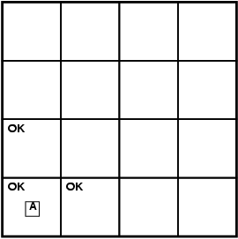
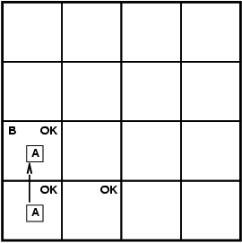
Exploring a Wumpus World
Notes:
Note: The image is taken from Source : https://www.ics.uci.edu/~welling/teaching/ICS171fall10/PropLogic171fall10.ppt
The agent’s goal is to find the gold and bring it back to the start as quickly as possible, without getting killed.
1000 points reward for climbing out of the cave with the gold
1 point deducted for every action taken
10000 points penalty for getting killed

Slide 20
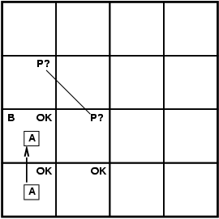
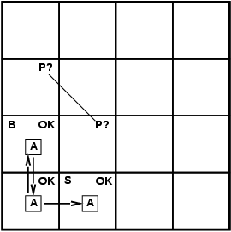
Exploring a Wumpus World
Notes:
Note: The image is taken from Source --https://www.ics.uci.edu/~welling/teaching/ICS171fall10/PropLogic171fall10.ppt

Slide 21
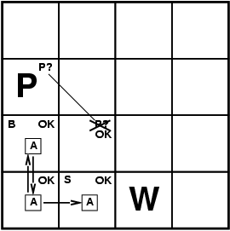
Exploring a Wumpus World
If the Wumpus were
here, stench should be
here. Therefore it is
here.
Since, there is no breeze
here, the pit must be
there
We need rather sophisticated reasoning here!
Notes:
Note: The image is taken from Source --https://www.ics.uci.edu/~welling/teaching/ICS171fall10/PropLogic171fall10.ppt

Slide 22

Exploring a Wumpus World
Notes:
Note: The image is taken from Source --https://www.ics.uci.edu/~welling/teaching/ICS171fall10/PropLogic171fall10.ppt

Slide 23
The “Hunt the Wumpus” Agent
Some Atomic Propositions
S12 = There is a stench in cell (1,2)
B34 = There is a breeze in cell (3,4)
W22 = The Wumpus is in cell (2,2)
V11 = We have visited cell (1,1)
OK11 = Cell (1,1) is safe.
Some rules
(R1) ~S11 => ~W11 ^ ~W12 ^ ~W21
(R2) ~S21 => ~W11 ^ ~W21 ^ ~W22 ^ ~W31
(R3) ~S12 => ~W11 ^ ~W12 ^ ~W22 ^ ~W13
(R4) S12 => W13 v W12 v W22 v W11
etc
Note that the lack of variables requires us to give similar rules for each cell.
Notes:
Source : http://web.cecs.pdx.edu/~mperkows/CLASS_410AER/2011.004.Wumpus-world-propositional-logic.ppt

Slide 24
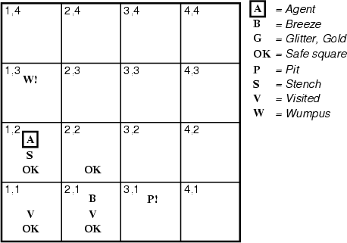
After the third move
We can prove that the Wumpus is in (1,3) using the four rules given.
Notes:
Note: The image is taken from Source -- http://web.cecs.pdx.edu/~mperkows/CLASS_410AER/2011.004.Wumpus-world-propositional-logic.ppt

Slide 25
Proving W13
(R1) ~S11 => ~W11 ^ ~W12 ^ ~W21
~S11
Apply MP with ~S11 and R1:
~W11 ^ ~W12 ^ ~W21
Apply And-Elimination to this we get 3 sentences:
~W11, ~W12, ~W21
Apply MP to ~S21 and R2, then applying And-elimination:
~W22, ~W21, ~W31 a
Apply MP to S12 and R4 we obtain:
W13 v W12 v W22 v W11
Apply Unit resolution on (W13 v W12 v W22 v W11) and ~W11
W13 v W12 v W22
Apply Unit Resolution with (W13 v W12 v W22) and ~W22
W13 v W12
Apply UR with (W13 v W12) and ~W12
W13
QED
~W11 ^ ~W12 ^ ~W21
~S21
~W22, ~W21, ~W31
R2
S12
R4
(W13 v W12 v W22 v W11)
~W11
(W13 v W12 v W22)
~W22
~W12
W13 v W12
W13
Notes:
Source : http://web.cecs.pdx.edu/~mperkows/CLASS_410AER/2011.004.Wumpus-world-propositional-logic.ppt

Slide 26
Problems with the propositional Wumpus hunter
Lack of variables prevent stating more general rules.
E.g., we need a set of similar rules for each cell
Change of the KB over time is difficult to represent
Standard technique is to index facts with the time when they’re true
This means we have a separate KB for every time point.
Notes:
Source : http://web.cecs.pdx.edu/~mperkows/CLASS_410AER/2011.004.Wumpus-world-propositional-logic.ppt

Slide 27
First-Order Logic
First-Order Logic (FOL) models the world in terms of
Objects, which are things with individual identities
Properties of objects that distinguish them from other objects
Relations that hold among sets of objects
Functions, which are a subset of relations where there is only one “value” for any given “input”
Examples:
Objects: Students, lectures, companies, cars ...
Relations: Brother-of, bigger-than, outside, part-of, has-color, occurs-after, owns, visits, precedes,
Properties: blue, oval, even, large, ...
Functions: father-of, best-friend, second-half, one-more-than ...
Notes:
Source : https://www.cs.swarthmore.edu/~eeaton/teaching/cs63/slides/Logic.ppt

Slide 28
First-Order Logic : Syntax
Constants KingJohn, 2, NUS,...
Predicates Brother, >,...
Functions Sqrt, LeftLegOf,...
Variables x, y, a, b,...
Connectives ¬, ⇒, ∧, ∨, ⇔
Equality =
Quantifiers ∀, ∃
Notes:
Source : https://www.cs.swarthmore.edu/~eeaton/teaching/cs63/slides/Logic.ppt

Slide 29
First-Order Logic
A term (denoting a real-world individual) is a constant symbol, a variable symbol, or an n-place function of n terms.
x and f(x₁, ..., x_{n}) are terms, where each x_{i} is a term.
A term with no variables is a ground term.
An atomic sentence (which has value true or false) is an n-place predicate of n terms.
A complex sentence is formed from atomic sentences connected by the logical connectives:
¬P, P∨Q, P∧Q, P→Q, P↔Q where P and Q are sentences
A quantified sentence adds quantifiers ∀ and ∃.
A well-formed formula (wff) is a sentence containing no “free” variables. That is, all variables are “bound” by universal or existential quantifiers.
(∀x)P(x,y) has x bound as a universally quantified variable, but y is free.
Notes:
Source : https://www.cs.swarthmore.edu/~eeaton/teaching/cs63/slides/Logic.ppt

Slide 30
First-Order Logic
Examples---
Universal quantifiers are often used with “implies” to form “rules”:
(∀x) student(x) → smart(x) means “All students are smart”
Universal quantification is rarely used to make blanket statements about every individual in the world:
(∀x)student(x)∧smart(x) means “Everyone in the world is a student and is smart”
Existential quantifiers are usually used with “and” to specify a list of properties about an individual:
(∃x) student(x) ∧ smart(x) means “There is a student who is smart”
Every gardener likes the sun.
∀x gardener(x) → likes(x,Sun)
You can fool some of the people all of the time.
∃x ∀t person(x) ∧time(t) → can-fool(x,t)
You can fool all of the people some of the time.
∀x ∃t (person(x) → time(t) ∧can-fool(x,t))
∀x (person(x) → ∃t (time(t) ∧can-fool(x,t)))
Notes:
Source : https://www.cs.swarthmore.edu/~eeaton/teaching/cs63/slides/Logic.ppt

Slide 31
First-Order Logic : Semantics
Domain M: the set of all objects in the world (of interest)
Interpretation I: It includes
Assign each constant to an object in M
Define each function of n arguments as a mapping M^{n} => M
Define each predicate of n arguments as a mapping M^{n} => {T, F}
Therefore, every ground predicate with any instantiation will have a truth value
In general there is an infinite number of interpretations because |M| is infinite
Define logical connectives: ~, ^, ∨, =>, <=> as in PL
Define semantics of (∀x) and (∃x)
Notes:
Source : https://www.cs.swarthmore.edu/~eeaton/teaching/cs63/slides/Logic.ppt

Slide 32
First-Order Logic : Semantics
(∀x) P(x) is true iff P(x) is true under all interpretations
(∃x) P(x) is true iff P(x) is true under some interpretation
Model: an interpretation of a set of sentences such that every sentence is True
A sentence is:
Satisfiable, if it is true under some interpretation
Valid, if it is true under all possible interpretations
Inconsistent, if there does not exist any interpretation under which the sentence is true
Logical consequence: S |= X if all models of S are also models of X
Notes:
Source : https://www.cs.swarthmore.edu/~eeaton/teaching/cs63/slides/Logic.ppt

Slide 33
Expressing Uniqueness
Sometimes we want to say that there is a single and unique object that satisfies a certain condition
“There exists a unique x such that king(x) is true”
∃x king(x) ∧ ∀y (king(y) → x=y)
∃x king(x) ∧ ¬∃y (king(y) ∧ x≠y)
∃! x king(x)
“Every country has exactly one ruler”
∀c country(c) → ∃! r ruler(c,r)
Iota operator: “ι x P(x)” means “the unique x such that p(x) is true”
“The unique ruler of Freedonia is dead”
dead(ι x ruler(freedonia,x))
Notes:
Source : https://www.cs.swarthmore.edu/~eeaton/teaching/cs63/slides/Logic.ppt

Slide 34
Notational Differences
Different Symbols for and, or, not, implies, ...
∀ ∃ ⇒ ⇔ ∧ ∨ ¬ • ⊃
p v (q ^ r)
p + (q * r)
etc
Prolog
cat(X) :- furry(X), meows (X), has(X, claws)
Lispy Notations
(forall ?x (implies (and (furry ?x)
(meows ?x)
(has ?x claws))
(cat ?x)))
Notes:
Source : https://www.cs.swarthmore.edu/~eeaton/teaching/cs63/slides/Logic.ppt

Slide 35
Logical Agents for Wumpus World
Three (non-exclusive) agent architectures:
Reflex Agents
Have rules that classify situations, specifying how to react to each possible situation
Model-based Agents
Construct an internal model of their world
Goal-based Agents
Form goals and try to achieve them
Notes:
Source : https://www.cs.swarthmore.edu/~eeaton/teaching/cs63/slides/Logic.ppt

Slide 36
A Simple Reflex Agent
Rules to map percepts into observations:
∀b,g,u,c,t Percept([Stench, b, g, u, c], t) → Stench(t)
∀s,g,u,c,t Percept([s, Breeze, g, u, c], t) → Breeze(t)
∀s,b,u,c,t Percept([s, b, Glitter, u, c], t) → AtGold(t)
Rules to select an action given observations:
∀t AtGold(t) → Action(Grab, t);
Some difficulties:
Consider Climb. There is no percept that indicates the agent should climb out – position and holding gold are not part of the percept sequence.
Loops – the percept will be repeated when you return to a square, which should cause the same response (unless we maintain some internal model of the world).
Notes:
Source : https://www.cs.swarthmore.edu/~eeaton/teaching/cs63/slides/Logic.ppt

Slide 37
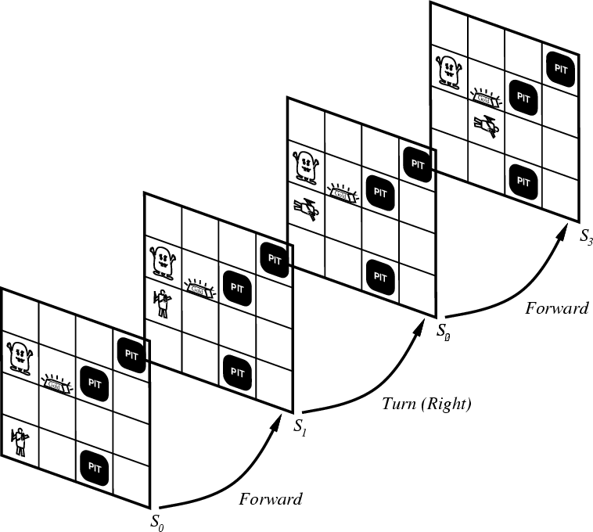
Representing Change
Representing change in the world in logic can be tricky.
One way is just to change the KB:
Add and delete sentences from the KB to reflect changes
How do we remember the past, or reason about changes?
Situation calculus is another way:
A situation is a snapshot of the world at some instant in time
When the agent performs an action A in situation S1,
the result is a new situation S2.
Notes:
Note: The image is taken from Source -- https://www.cs.swarthmore.edu/~eeaton/teaching/cs63/slides/Logic.ppt

Slide 38
Situations
Notes:
Note: The image is taken from Source --https://www.cs.swarthmore.edu/~eeaton/teaching/cs63/slides/Logic.ppt

Slide 39
Situation Calculus
A situation is a snapshot of the world at an interval of time during which nothing changes.
Every true or false statement is made with respect to a particular situation:
Add situation variables to every predicate.
At(Agent,1,1) becomes at(Agent,1,1,s0): at(Agent,1,1) is true in situation (i.e., state) s0.
Alternatively, add a special 2nd-order predicate, holds(f,s), that means “f is true in situation s.” E.g., holds(at(Agent,1,1),s0)
Add a new function, result(a,s), that maps a situation s into a new situation as a result of performing action a. For example, result(forward, s) is a function that returns the successor state (situation) to s
Example: The action agent-walks-to-location-y could be represented by
(∀x)(∀y)(∀s) (at(Agent,x,s) ∧ ¬onbox(s)) → at(Agent,y,result(walk(y),s))
Notes:
Source : https://www.cs.swarthmore.edu/~eeaton/teaching/cs63/slides/Logic.ppt

Slide 40
Deducing Hidden Properties
From the perceptual information, we obtain in situations and can infer properties of locations.
∀l,s at(Agent,l,s) ∧ Breeze(s) → Breezy(l)
∀l,s at(Agent,l,s) ∧ Stench(s) → Smelly(l)
Neither Breezy nor Smelly need situation arguments because pits and Wumpuses do not move around.
Notes:
Source : https://www.cs.swarthmore.edu/~eeaton/teaching/cs63/slides/Logic.ppt

Slide 41
Deducing Hidden Properties II
We need to write some rules that relate various aspects of a single world state (as opposed to across states).
There are two main kinds of such rules:
Causal rules reflect the assumed direction of causality in the world:
(∀l1,l2,s) At(Wumpus,l1,s) ∧ Adjacent(l1,l2) → Smelly(l2)
(∀ l1,l2,s) At(Pit,l1,s) ∧ Adjacent(l1,l2) → Breezy(l2)
Systems that reason with causal rules are called model-based reasoning systems.
Diagnostic rules infer the presence of hidden properties directly from the percept-derived information. We have already seen two diagnostic rules:
(∀ l,s) At(Agent,l,s) ∧ Breeze(s) → Breezy(l)
(∀ l,s) At(Agent,l,s) ∧ Stench(s) → Smelly(l)
Notes:
Source : https://www.cs.swarthmore.edu/~eeaton/teaching/cs63/slides/Logic.ppt

Slide 42
Goal-based Agents
Once the gold is found, it is necessary to change strategies. So now we need a new set of action values.
We could encode this as a rule:
(∀s) Holding(Gold,s) → GoalLocation([1,1]),s)
We must now decide how the agent will work out a sequence of actions to accomplish the goal.
Three possible approaches are:
Inference: good versus wasteful solutions
Search: make a problem with operators and set of states
Planning: to be discussed later
Notes:
Source : https://www.cs.swarthmore.edu/~eeaton/teaching/cs63/slides/Logic.ppt

Slide 43
Self Assessment Questions
Knowledge and reasoning also play a crucial role in dealing with __________________ environment.
Completely Observable
Partially Observable
Neither Completely nor Partially Observable
Only Completely and Partially Observable
Answer: b.

Slide 44
Self Assessment Questions
“A knowledge-based agent can combine general knowledge with current percepts to infer hidden aspects of the current state prior to selecting actions.” Is the statement true or false?
True
False
Answer: a

Slide 45
Self Assessment Questions
A) Knowledge base (KB) is consists of set of statements. B) Inference is deriving a new sentence from the KB.
Choose the correct option.
A is true, B is true
A is false, B is false
A is true, B is false
A is false, B is true
Answer: a

Slide 46
Self Assessment Questions
Wumpus World is a classic problem, best example of _______.
Single player Game
Two player Game
Reasoning with Knowledge
Knowledge based Game
Answer: C

Slide 47
Self Assessment Questions
“The rule of Universal Instantiation (UI for short) says that we can infer any sentence obtained by substituting a ground term (a term without variables) for the variable.” Is the statement true or false?
True
False
Answer: a

Slide 48
Self Assessment Questions
“A knowledge engineer has the job of extracting knowledge from an expert and building the expert system knowledge base.” Is the statement true or false?
True
False
Answer: a

Slide 49
Self Assessment Questions
Uncertainty arises in the wumpus world because the agent’s sensors give only ___________.
Full & Global Information
Partial & Global Information
Partial & Local Information
Full & Local Informatio
Answer: c

Slide 50

Assignment
Consider three blocks A, B and C which can be stacked on top of each other, or on a table, for instance, in conﬁgurations like the following:
In this problem, we do not move the blocks around, but rather consider a ﬁxed conﬁguration of the blocks. In such a conﬁguration, let SA,B be a proposition symbol representing the fact that A is stacked above B, and similarly deﬁne SB,A, SA,C, SC,A, SB,C and SC,B. For instance, in the ﬁgure on the left, SC,A would be the only one of these symbols that is true. In the ﬁgure on the right, the only true symbols are SA,B, SB,C and SA,C. For parts (a-d) below, be sure to explicitly list all of the required clauses or sentences. Do not just give examples of a general pattern.
Notes:
Note – The image is taken from the source https://www.cs.princeton.edu/courses/archive/fall05/cos402/final/sample.pdf.

Slide 51
Assignment
Show how to represent using propositional logic the fact that if one block is stacked above another, then the second cannot be above the ﬁrst (for instance, if A is above B, then B cannot be above A).
Show how to represent the fact that if one block is stacked above a second block, which is in turn stacked above a third block, then the ﬁrst block must be stacked above the third block (for instance, if A is above B, and B is above C, then A must be above C).
Show how to represent the proposition that at least one block must have no blocks stacked above it.

Slide 52
Assignment
Let KB denote the conjunction of sentences in parts (a) and (b), and let α denote the sentence (or conjunction of sentences) in part (c). Convert KB ∧ ¬α to CNF and list all of its clauses.
Choose three pairs of clauses from part (d) that are eligible for resolution and show the result of resolving them. (Be sure to indicate which pairs you are resolving). Do not pick pairs that yield tautologies.

Slide 53
Document Link
Topic | URL | Notes
Knowledge and Reasoning | https://en.wikipedia.org/wiki/Artificial_intelligence | Outline knowledge and reasoning strategies with their representation.
Knowledge Agent Prepositional Logic First order logic Wumpus world | https://www.javatpoint.com/knowledge-based-agent-in-ai | Explains the idea of what is knowledge based agent , prepositional logic and how they are used in artificial intelligence concept.
Knowledge Agent Prepositional Logic First Order Logic Wumpus world | https://www.cs.ubc.ca/~hkhosrav/ai/slides/chapter7.pdf | Describe about first order logic and simple reflex agent.
Knowledge Agent Prepositional Logic First Order Logic | https://www.javatpoint.com/first-order-logic-in-artificial-intelligence | Summarize Wumpus world agent technique to solve real world problem.

Slide 54
Video Link
Topic | URL | Notes
Knowledge and Reasoning | https://www.youtube.com/watch?v=ZIuWSWbSoJE | Outline knowledge and reasoning strategies with their representation.
Knowledge Agent | https://www.youtube.com/watch?v=V-O-RFSRe-E | Explains the idea of what is knowledge based agent and how they are used in artificial intelligence concept.
Prepositional Logic First Order Logic | https://www.youtube.com/watch?v=CS-h-YmQSlw https://www.youtube.com/watch?v=p-ME3DW2BVg&list=PLzVTusWerVcKx3crsij5wrRfIqWp3UXc7 | Describe about prepositional logic, first order logic and simple reflex agent.
Wumpus World | https://www.youtube.com/watch?v=fnwjsO9ky9o | Summarizes Wumpus world agent technique to solve real world problem.

Slide 55
E- Book Link
Ebook name | Chapter | Page No. | Notes | URL
Artificial Intelligence: A Modern Approach by Stuart Russell and Peter Norvig, c 1995 Prentice-Hall, Inc. | Chapter 6 | 149-180 | Give a description about different types of knowledge based agents and its representations with examples. | https://www.cin.ufpe.br/~tfl2/artificial-intelligence-modern-approach.9780131038059.25368.pdf
Artificial Intelligence: A Modern Approach by Stuart Russell and Peter Norvig, c 1995 Prentice-Hall, Inc. | Chapter 7 | 185-213 | Give a description about different types of logic rules with examples. | https://www.cin.ufpe.br/~tfl2/artificial-intelligence-modern-approach.9780131038059.25368.pdf

